Slide 1

Sprint two elaboration
Amelia, Josh, Kyle, Zach

Slide 2
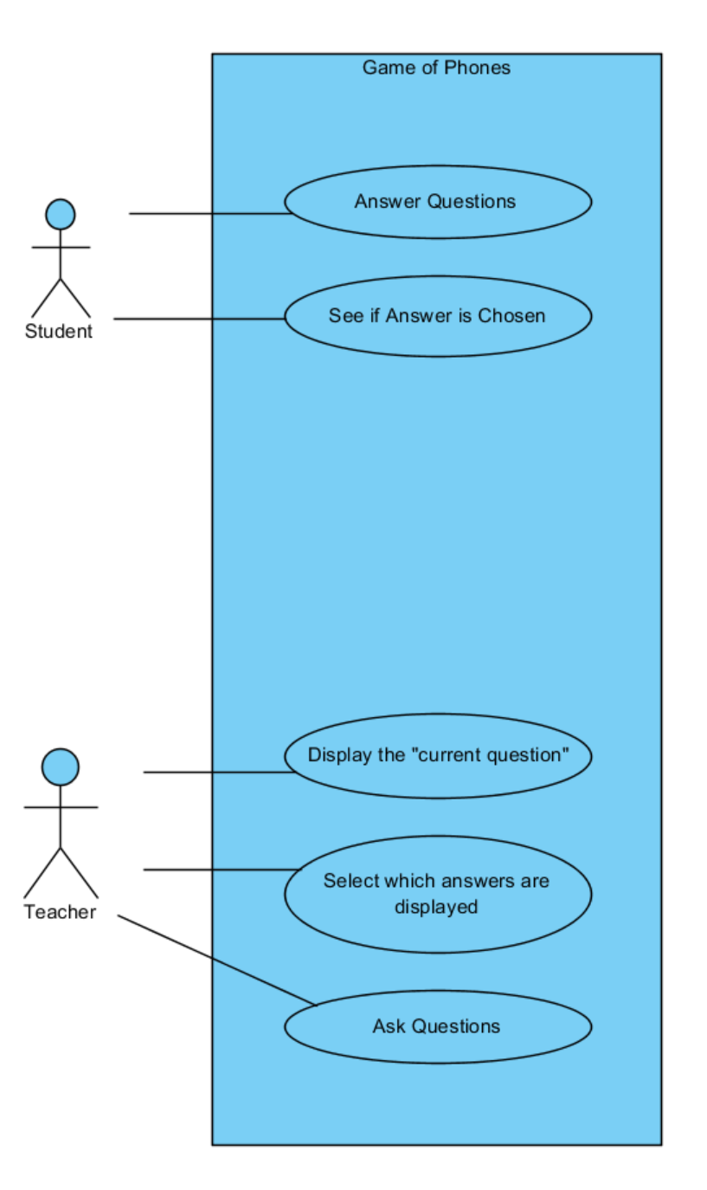

Slide 3
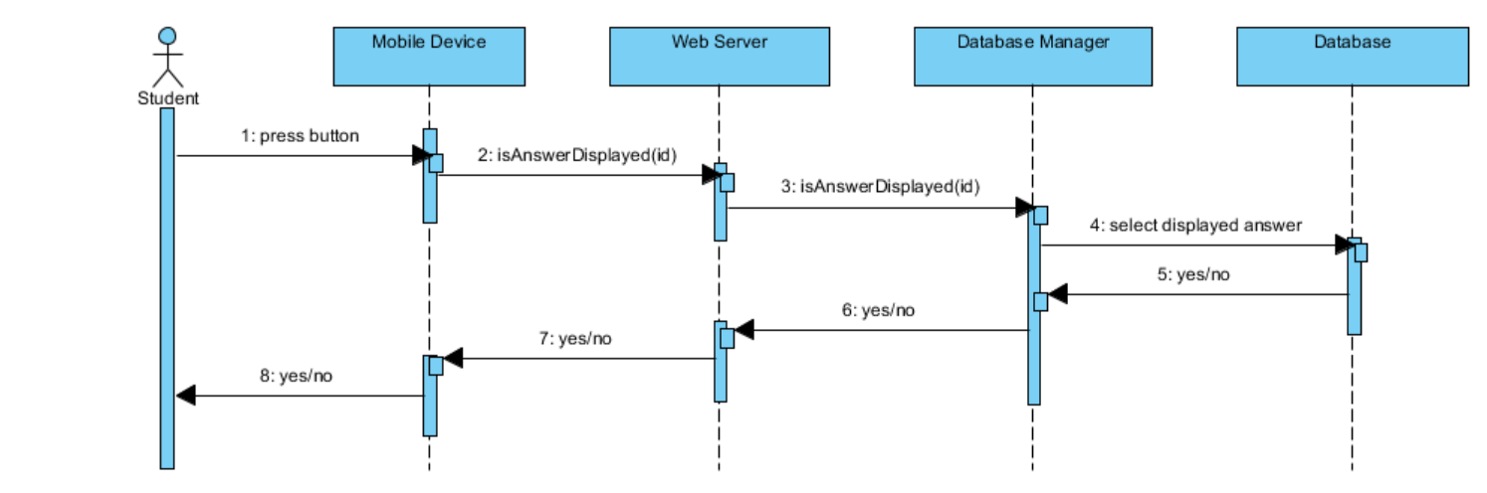

Slide 4
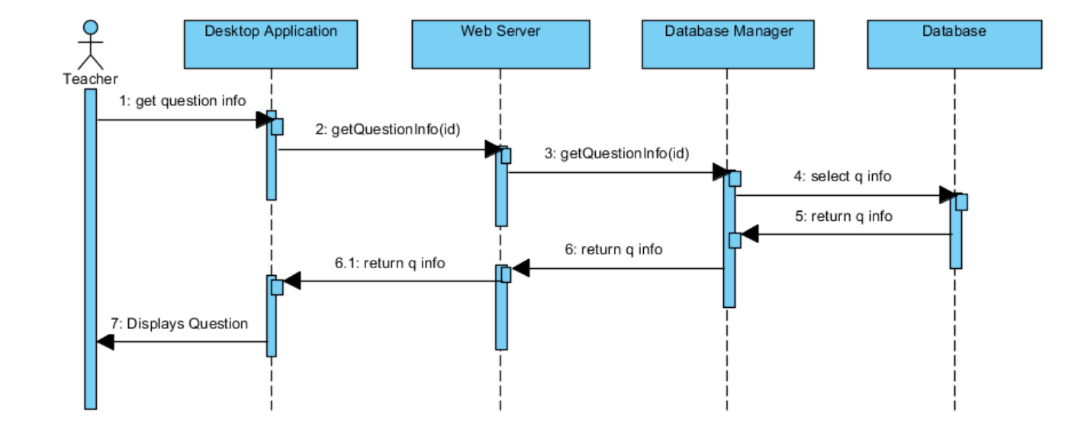

Slide 5
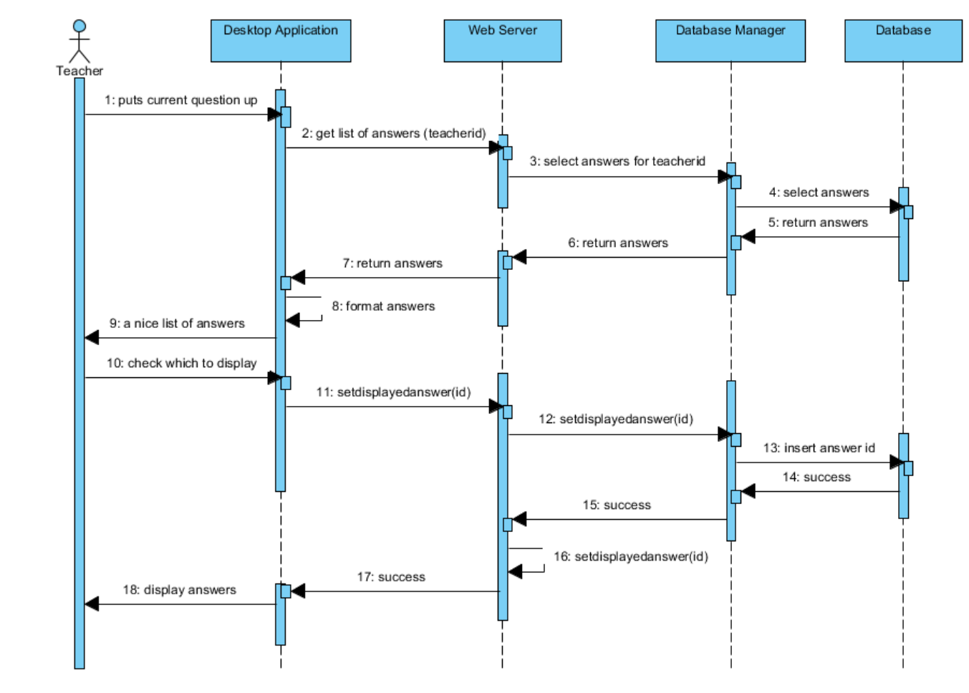

Slide 6
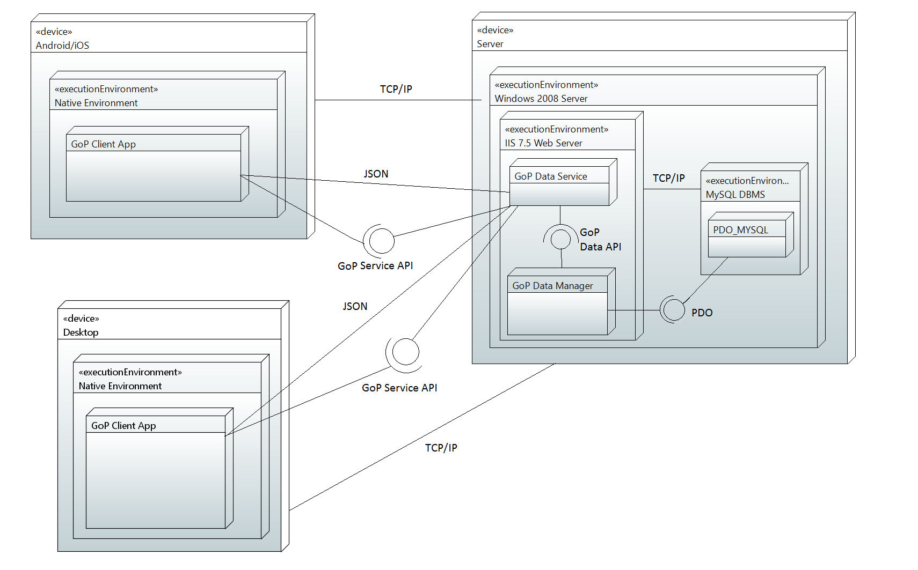

Slide 7
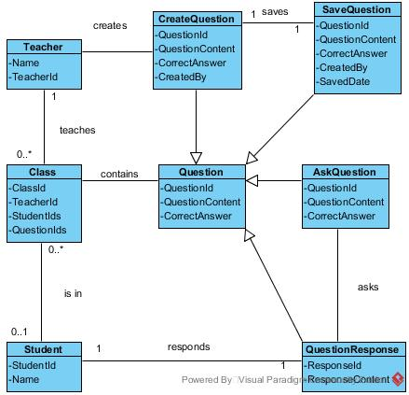

Slide 8
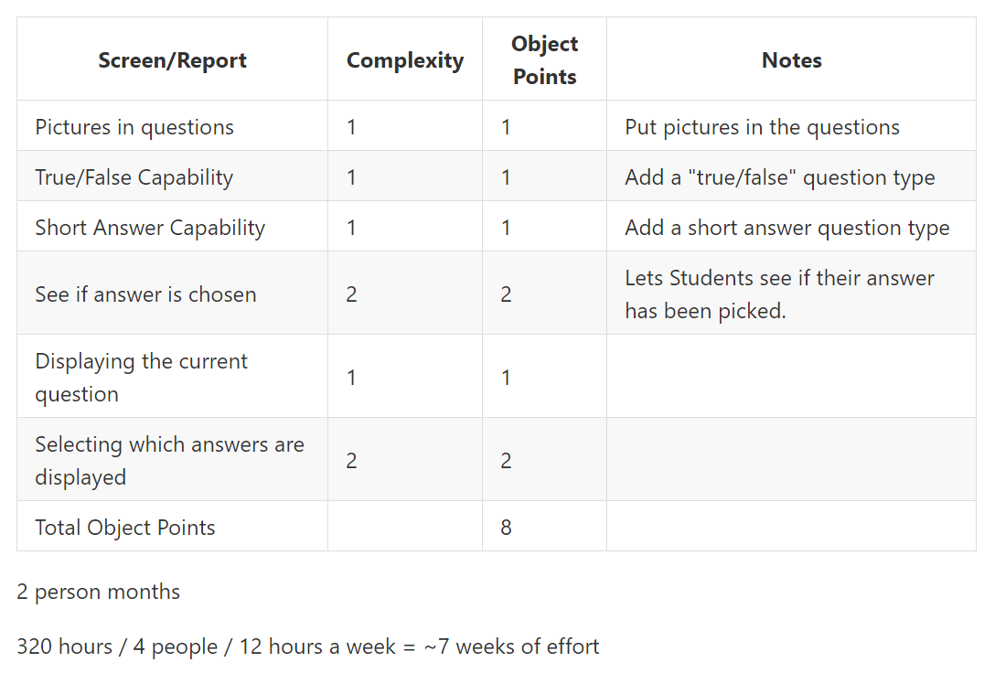

Slide 9
Risk assessment
Connectivity is mostly done
Just adding features to base from sprint 1

Slide 10
Acceptance plan
Display Current Question
Selected question is displayed on desktop application
Selected Displayed Answers
Desktop app can display selected answers
See if Answer is Chosen
App notifies user when their answer is chosen
Tests
Choose a question and make sure it is being displayed on the desktop
Select answers to be displayed and make sure they are being displayed
Select an answer to be displayed and make sure the app notifies the user

Slide 11
What comes next
Kyle/Josh (Apple) and Amelia (Android):
Database connectivity
Seeing if answer is chosen
Finishing Sprint One tasks
Zach (Desktop):
Displaying a question
Selecting a student Answer
Finishing Sprint One tasks
Amelia (Database):
Expanding functionality to include pictures

Slide 12
Questions?

